Slide 1
Vizsgaremek
KSH IT Zrt.

Slide 2
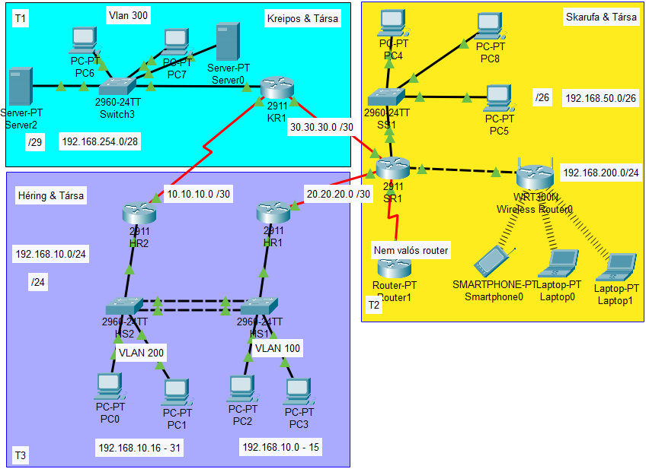
Topology types
:
Logical Topology concept
Physical Topology concept:
There is nothing yet.

Slide 3
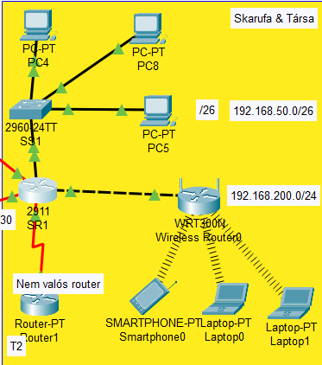
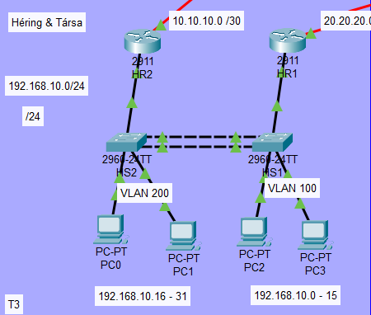
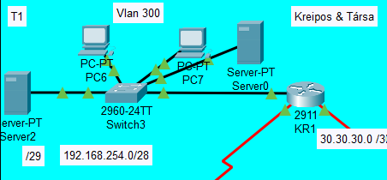
Divisions & members
Skarufa Ákos
Héring Máté
Kreipos Gábor

Slide 4
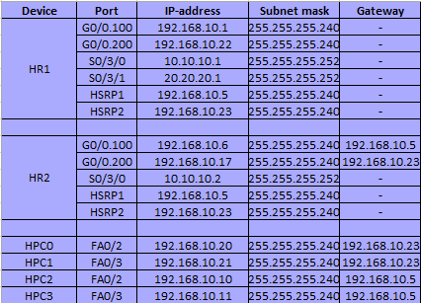
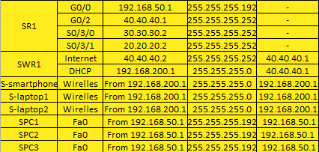
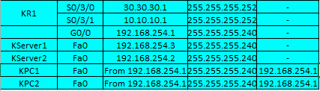
IP-ADDRESS TABLE

Slide 5
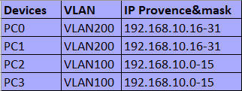
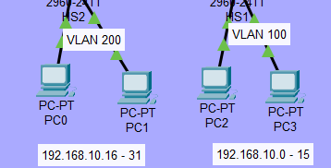
Vlan TABLE

Slide 6
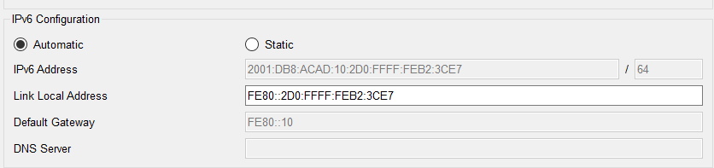
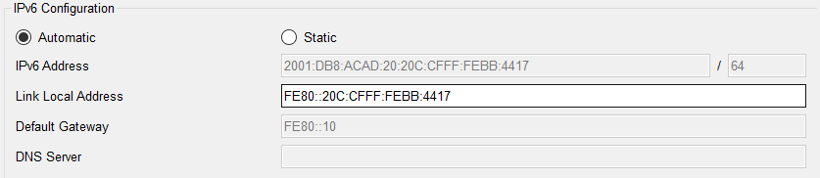
IPV6 adresses
Two different IPv6(SLAAC)

Slide 7
Passwords
SSH:
user: admin
password cisco
____________________________________
Console: cisco
Domain-name: kando.com
Password: cisco
WAN protocoll:
HR1:
user SR1
password cisco
SR1:
user HR1
password cisco

Slide 8
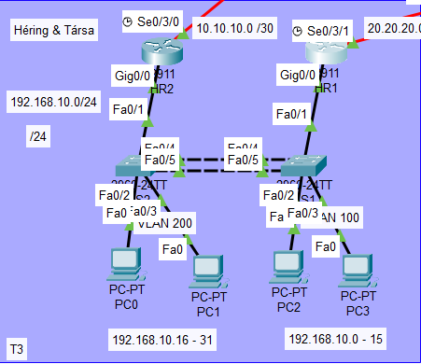
Héring máté

Slide 9
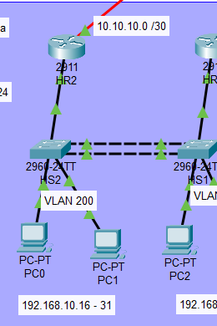
DIVISIONS (details)
HSRP protocoll:
It’s working
Virtual Router IP:
192.168.10.6
192.168.10.23
IPv6 cannot be done in Cisco.

Slide 10
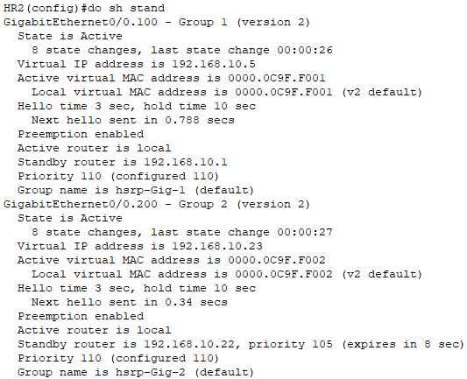
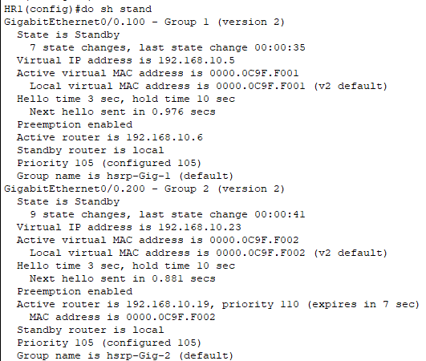
HSRP PROTOCOLL
HR2(Active)
HR1(Standby)

Slide 11
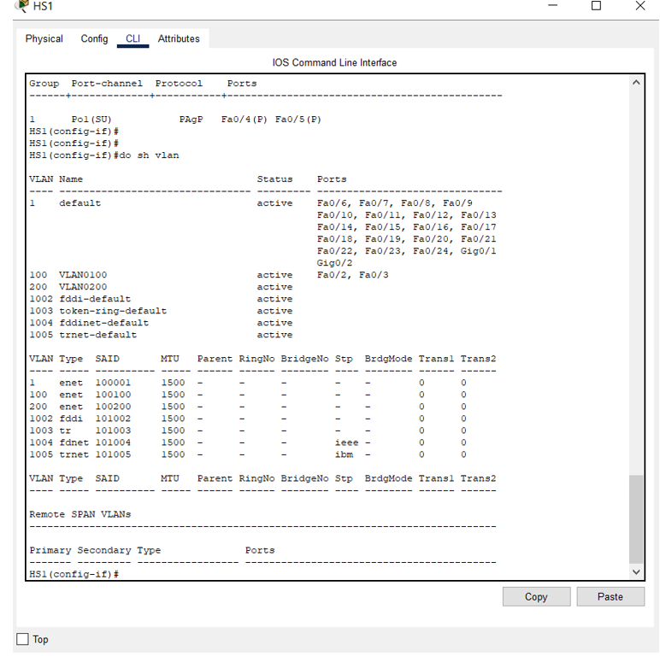
Divisions (details)
VLAN protocoll:
We have 2 different VLAN:
-100
-200
With two different IP range:
192.168.0-15 192.168.10.16-31

Slide 12
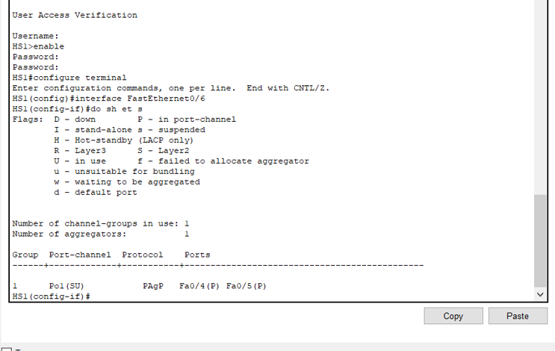
Division(details)
EtherChannel protocoll:
-It’s working good perfect LACP

Slide 13


DIVISIONS(DETAILS)
NAT Protocoll:
PAT: 199.133.65.1 192.168.10.1 - 31 (HR2)
Static NAT: 188.77.66.1 192.168.254.7 (KR1)

Slide 14
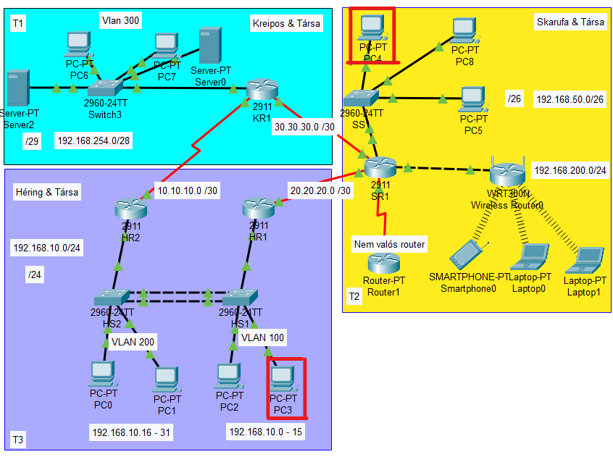
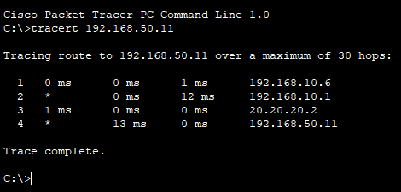
TRacert
PC3->PC4

Slide 15
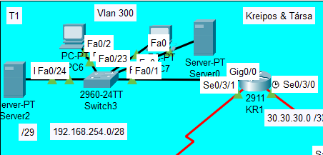
Kreipos Gábor

Slide 16
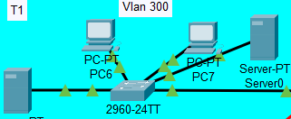
DIVISIONS (DETAILS)
LINUX & Windows server protocoll:

Slide 17
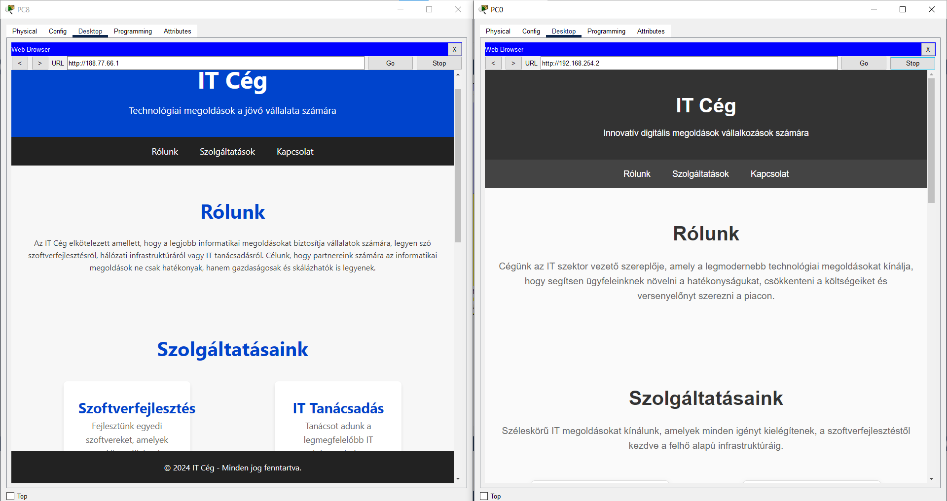
Divisions(details)
Server WEB

Slide 18
Division(details)
OSPF protocoll:
It’s really good and working well

Slide 19
Divisions (details)
Port-security is working on every single device

Slide 20
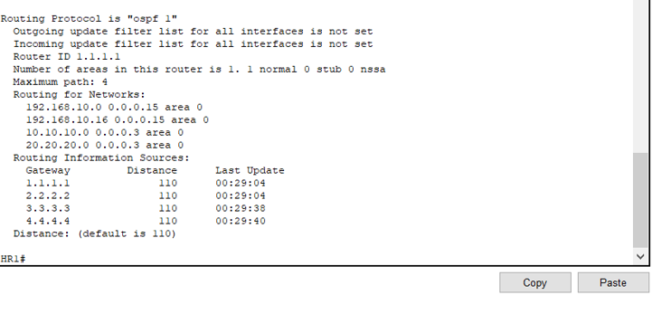
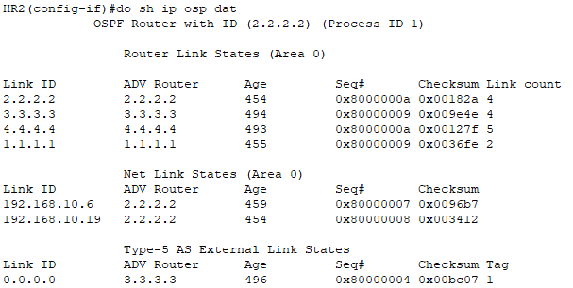
Ospf protocoll
HR1
HR2

Slide 21
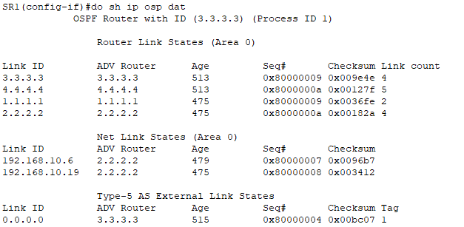
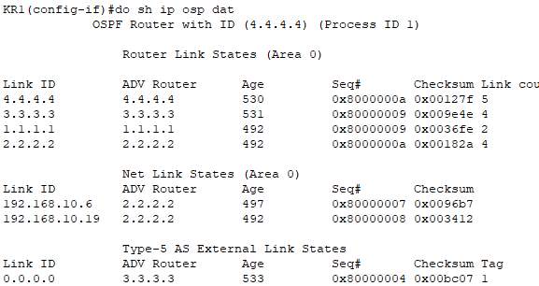
OSPF protocoll
SR1
KR1

Slide 22
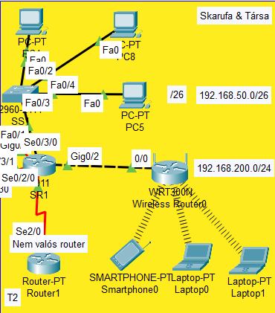
SKARUFA áKOS

Slide 23
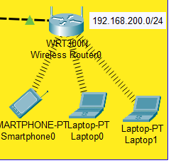
DIVISIONS (DETAILS)
WiFi protocoll:
192.168.200.1 is the main address
You can’t ping into the network, only out
With ACL protocoll, only „Héring és társai” reach the WiFi section (The test can be see later)
Stats:
Network: 192.168.200.0 255.255.255.0
Gateway: 40.40.40.1
DNS Server: 8.8.8.8

Slide 24
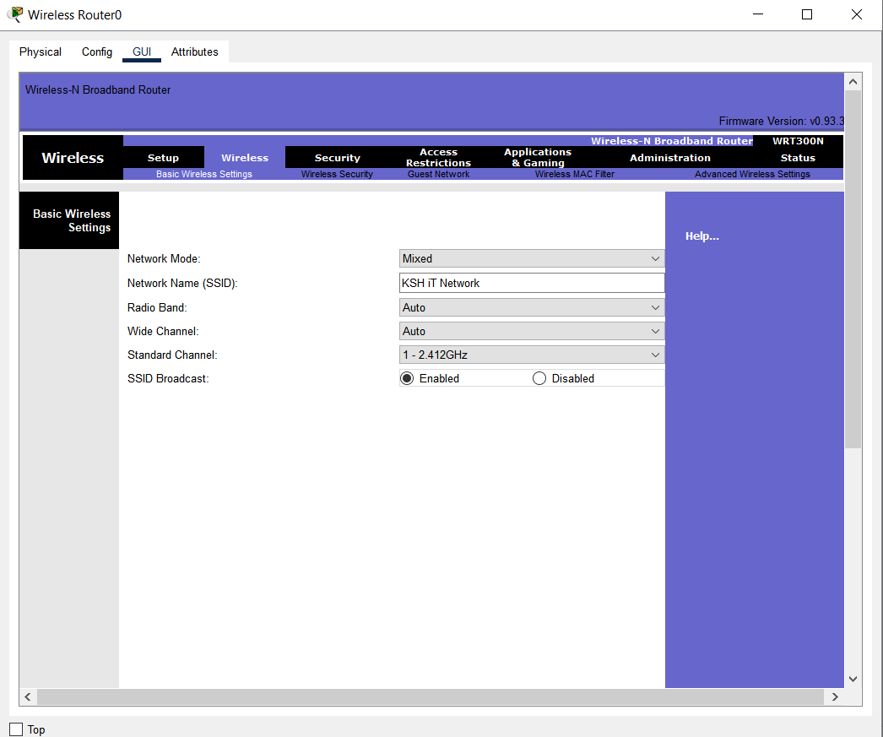
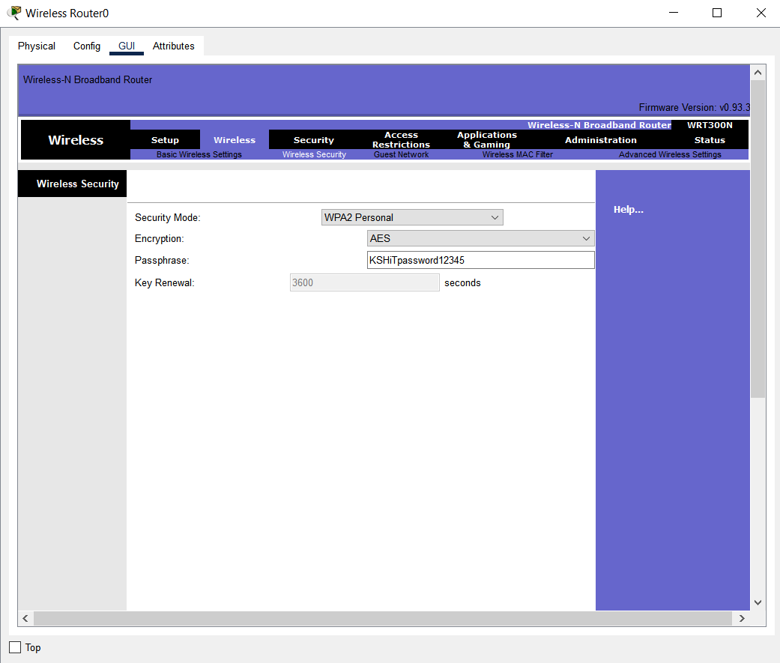
DIVISION(DETAILS)
SSID
Password
„KSH iT Network”
KSHiTpassword12345

Slide 25
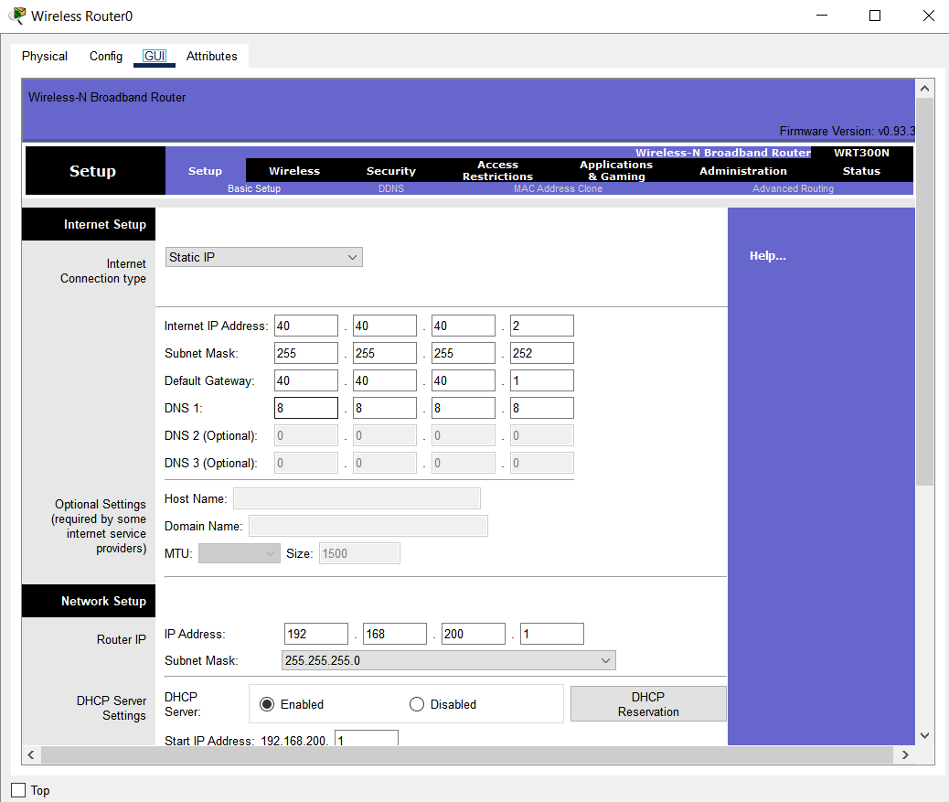
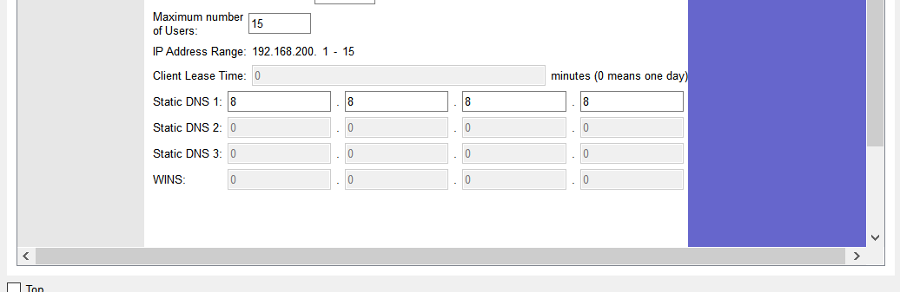
Division(details)
IP-addresses
IP-addresses

Slide 26
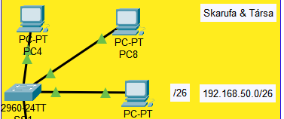
DIVISION (DETAILS)
Default IPv4 DHCP protocoll:
-The pool name is: Skarufa&tarsai
-Config: DR:192.168.50.1
N:192.168.50.0. 255.255.255.192

Slide 27
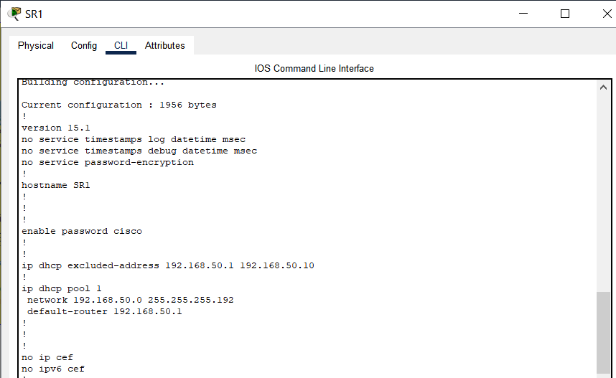
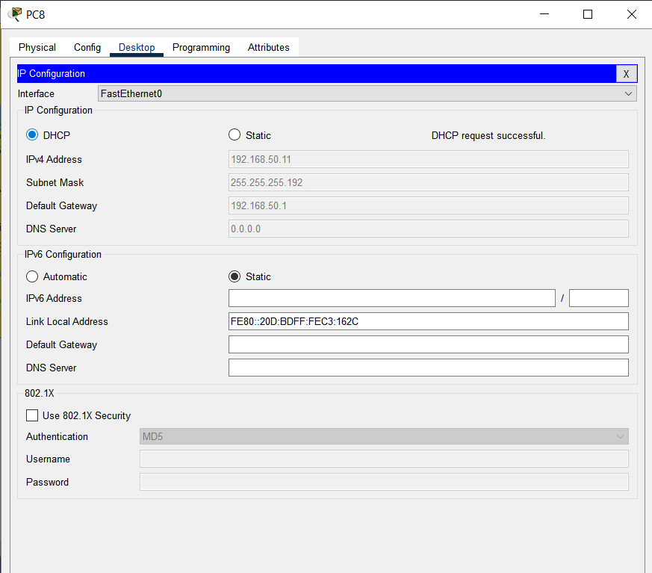
DIVISION(DETAILS)
DHCP-protocoll(Router)
DHCP-protocoll(PC)

Slide 28
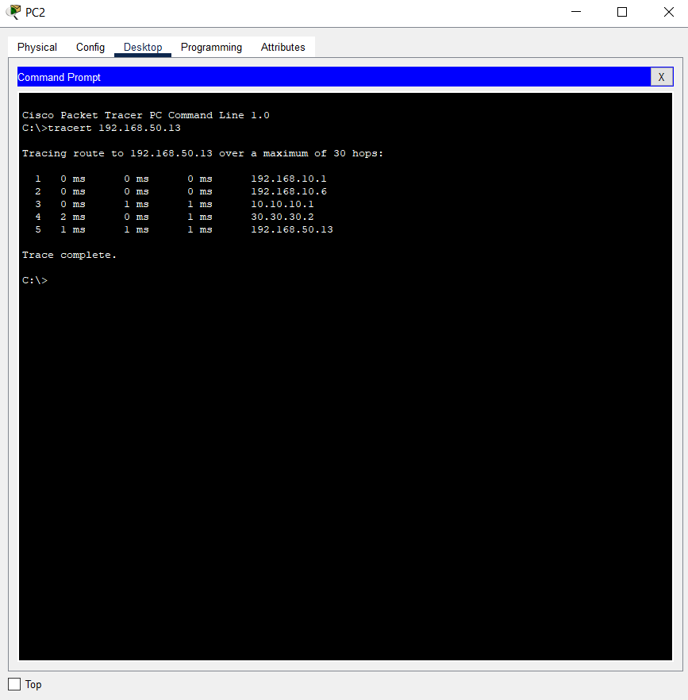
Tracert

Slide 29
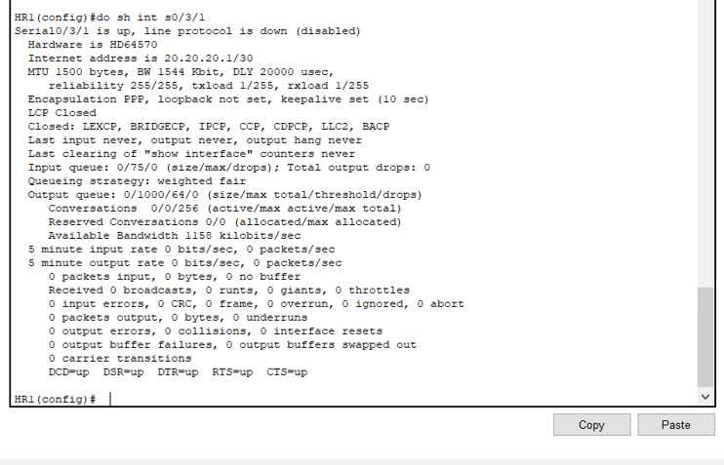
Division(details)

Slide 30
KSH It Zrt.
Héring Máté: cisco, config, documentation
Skaru: excel, word, Tables, ppt,
Kreip: casino, eating, server, eating, windows, eating and doing nothing.

